Slide 2
CQRS with Event Sourcing using the “Critter Stack”
Jeremy D. Miller

Slide 3

About Me
Owner and Founder of JasperFx Software LLC
Marten Core Team
Wolverine Project Leader
Longtime OSS Author
StructureMap et al
.NET since 1.0

Slide 4


The “Critter Stack”
Marten, Wolverine, Weasel (“Mustelidae”)
Server side development in .NET
Low ceremony coding model
High testability & low friction integration testing
Low friction developer experience
Robust system development

Slide 5
Event Sourcing and CQRS
Event Sourcing
A persistence pattern where system state is captured as an append only log of system state changes (events)
Command Query Responsibility Segregation
Architectural pattern that explicitly separates read and update operations for a data store

Slide 6
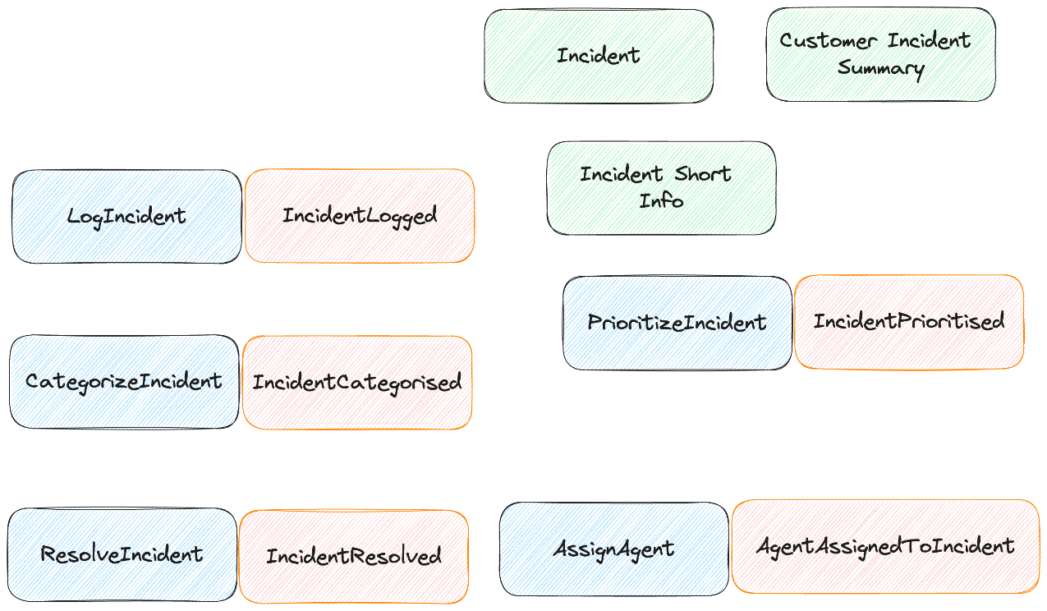
Event Storming

Slide 7

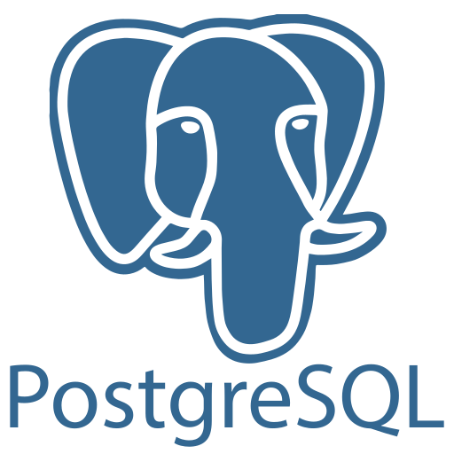
Marten
Open Source .NET Library
Uses PostgreSQL for Persistence
ACID Compliant Document Store
Integrated Event Sourcing

Slide 8
Event Sourcing with Marten

Slide 9
Our First Command Handler
With Marten and MVC Core for now…

Slide 10
Wolverine
Open Source .NET Framework
Command Executor
Local Queueing
Asynchronous Messaging
Alternative HTTP Service Framework
Strong Integration with Marten

Slide 11
Command Handler with Wolverine
Long hand
Short hand
HTTP endpoint

Slide 12
Projections with Marten

Slide 13
Fast Web Services
Projection data with Wolverine and Marten

Slide 14
Internal Event Handling

Slide 15
Integration Testing Support

Slide 16

Resources
Marten https://martendb.io
Wolverine https://wolverine.netlify.app
JasperFx Software LLC https://jasperfx.net
Critter Stack Discord https://discord.gg/jWbV73zjSh

